Slide 1
DSE 6300- DATA SCIENCE APPLICATIONS DEVELOPMENT
FINAL PROJECT - Stock Prediction Application
Karolina Konopka
Ahalya Pitchaikannu
Priyadharshini Pichai
Monday, April 25, 2022

Slide 2
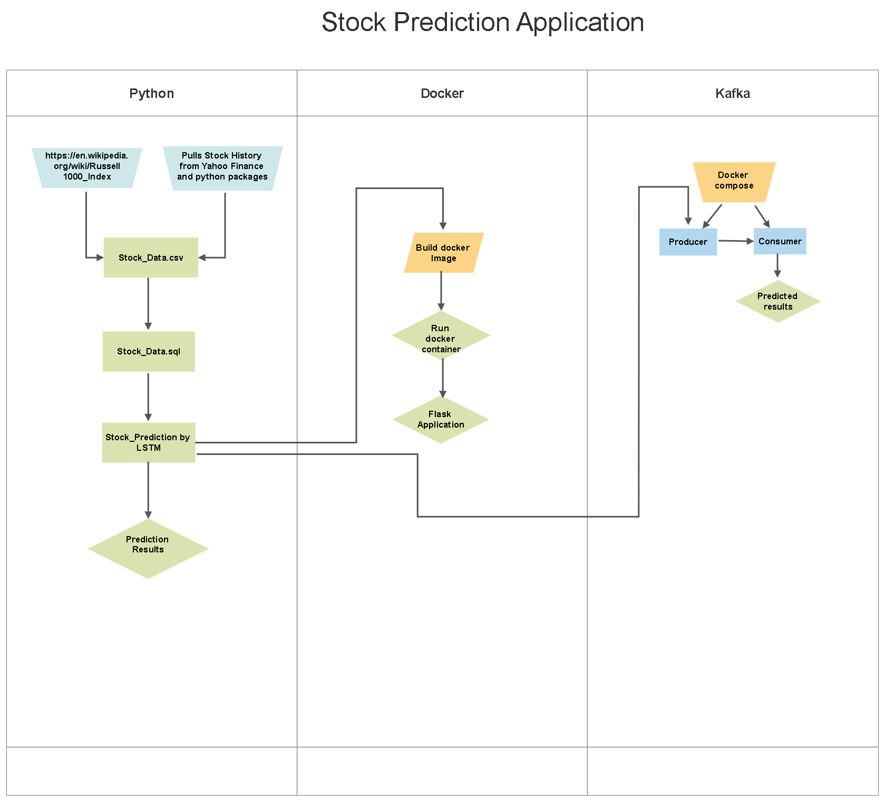
Objective and Workflow
Objective:
Aim is to create an application to predict the future values for the user selected stocks

Slide 3
Steps Followed
Application deployed :
Code integrated with flask to build an image and ran it using containers
Application streamed using Kafka:
Application published and subscribed using Kafka
Data Collection:
Data Pulling from Yahoo Finance
Model Prediction:
Import the libraries
Load the training dataset
Training the model
Normalizing the dataset
Building the model
Fitting the model
Predicting the values
Plotting the stock price

Slide 4
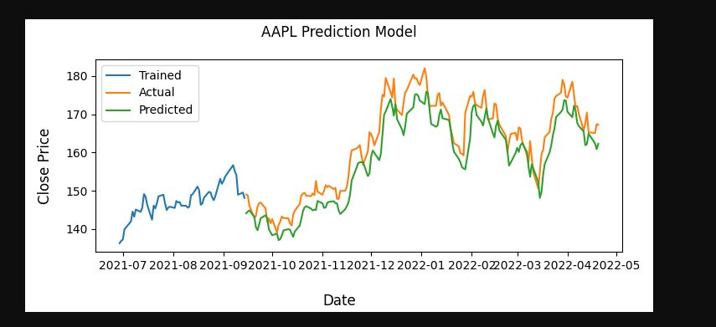
Stock Prediction Application

Slide 5
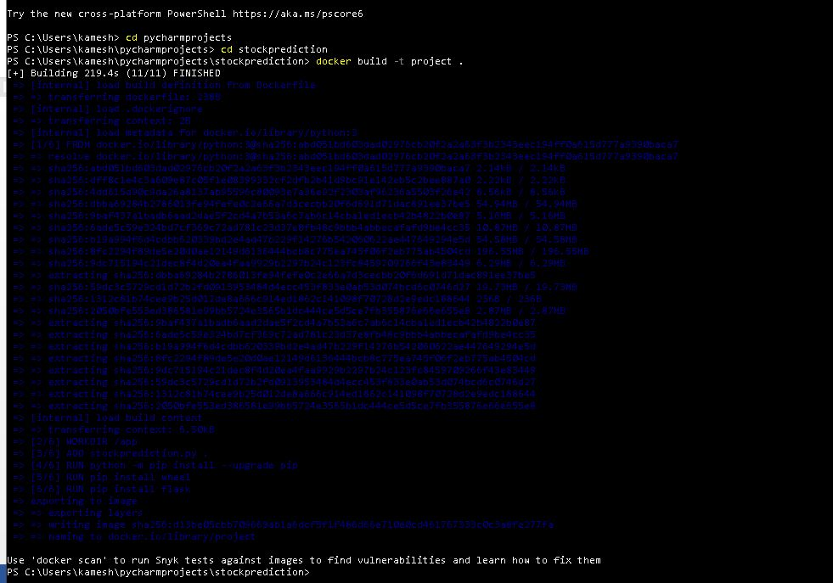
Stock Prediction Application - Docker

Slide 6
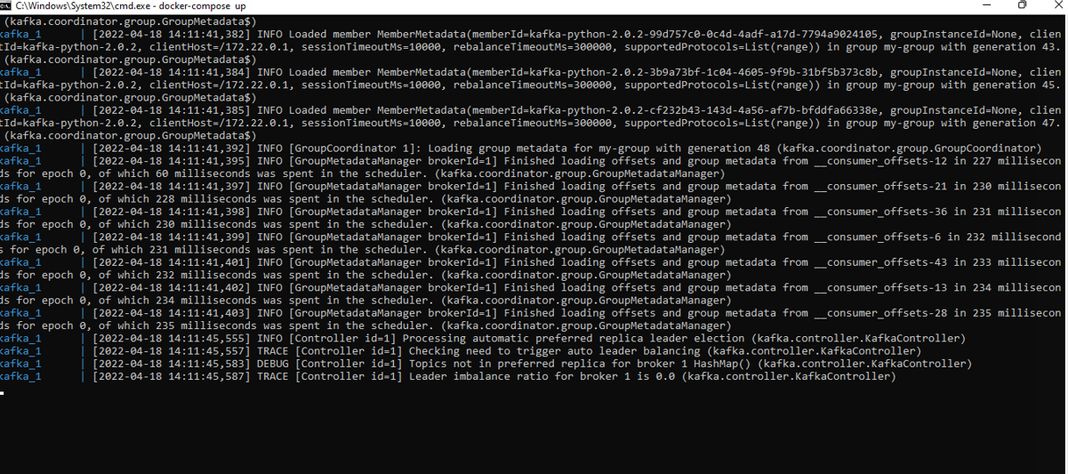
Stock Prediction Application - Kafka

Slide 7
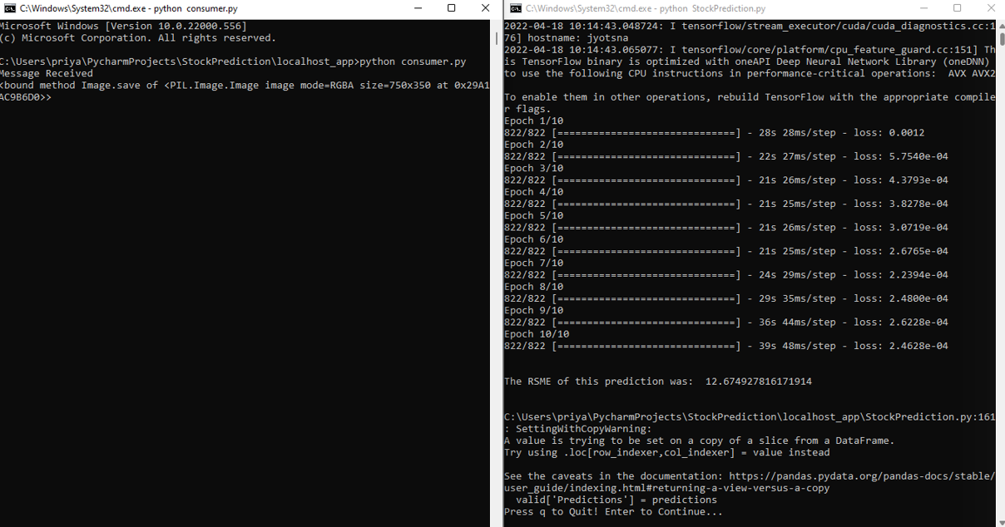
Stock Prediction Application - Kafka

Slide 8
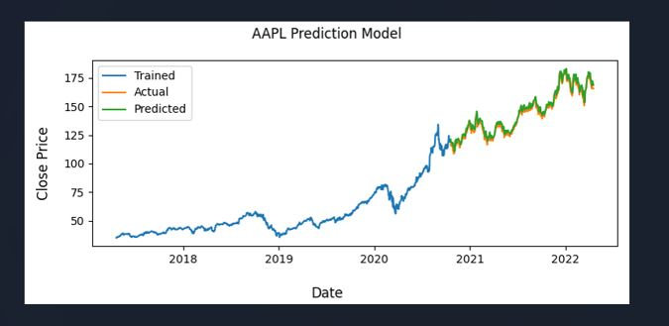
Stock Prediction Application - Kafka Prediction

Slide 9
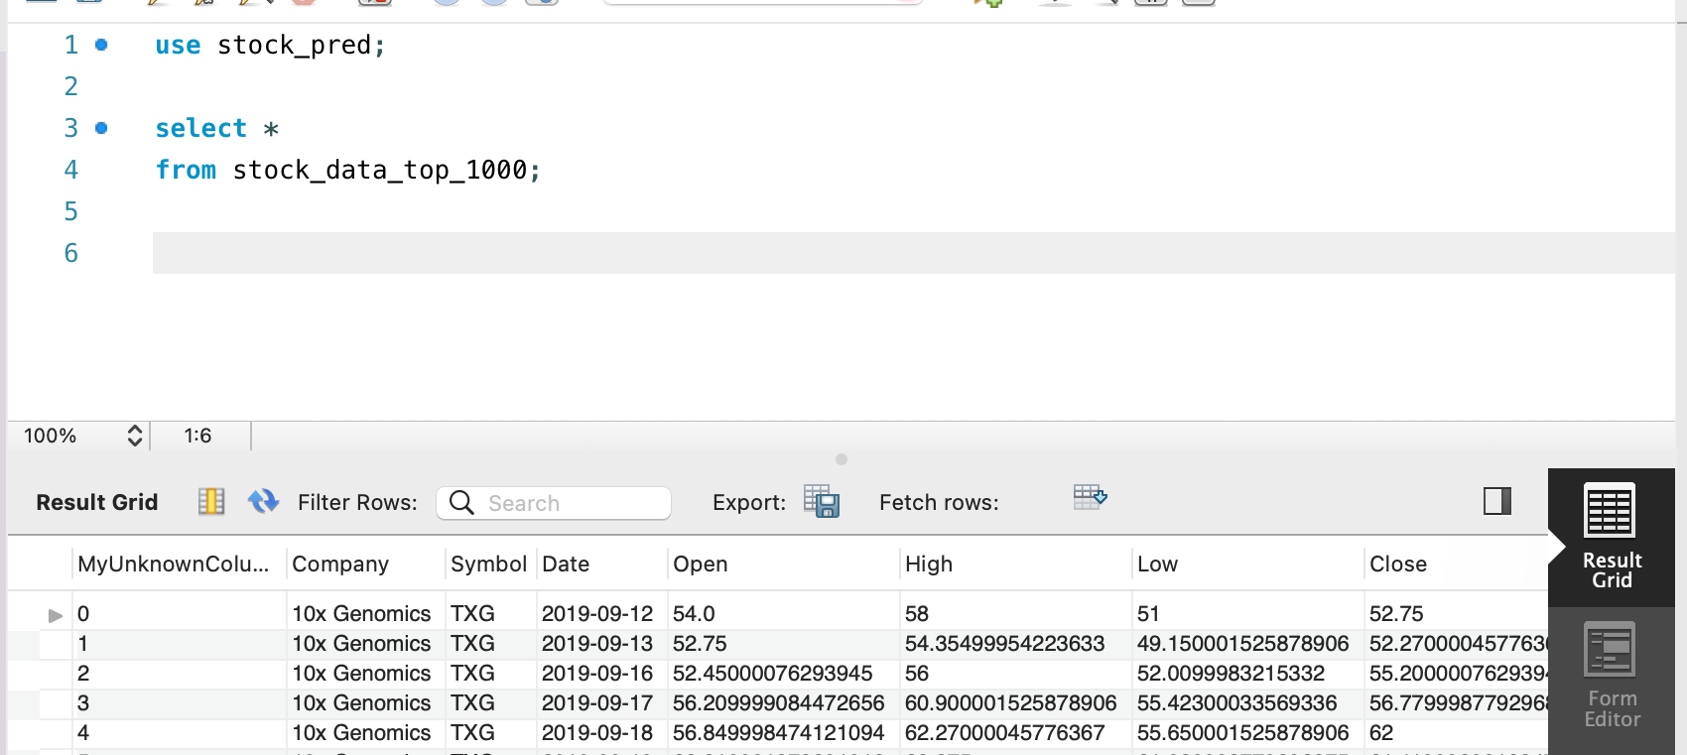
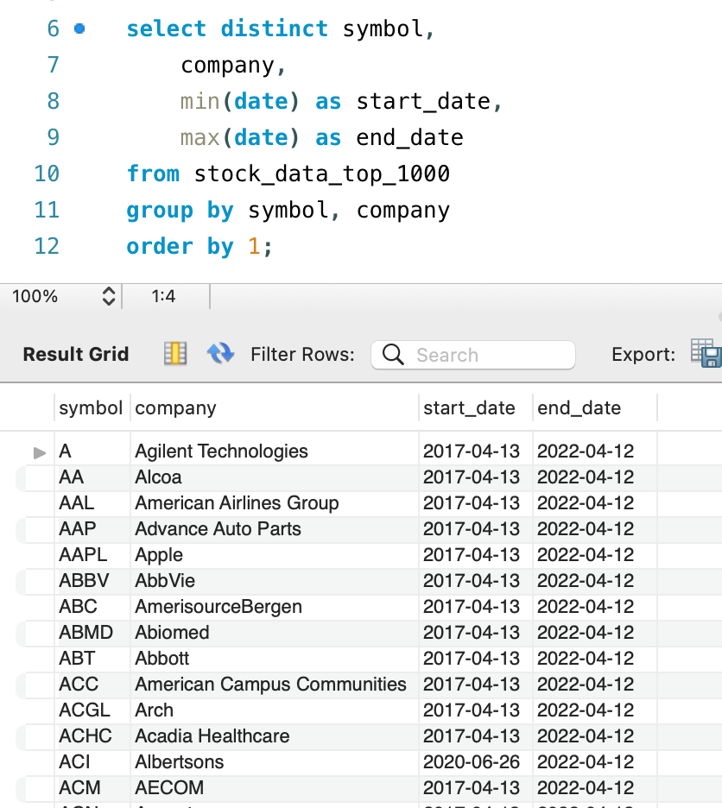
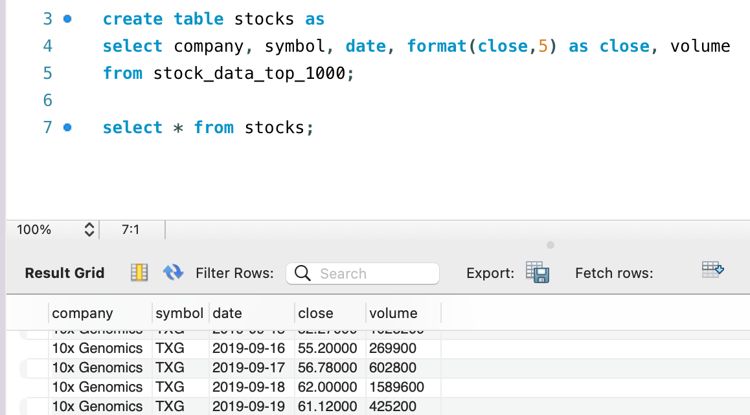
MySQL

Slide 10
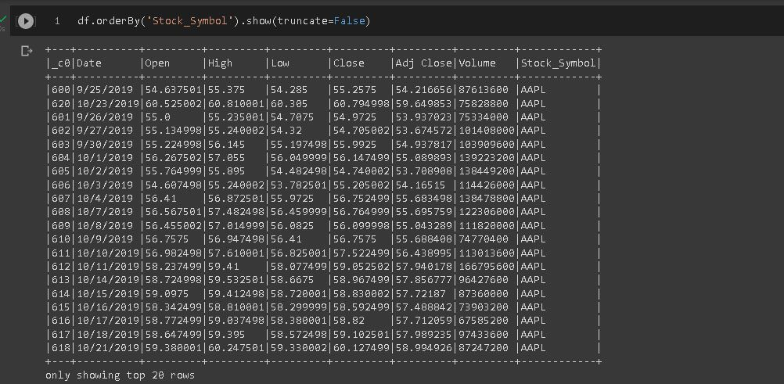
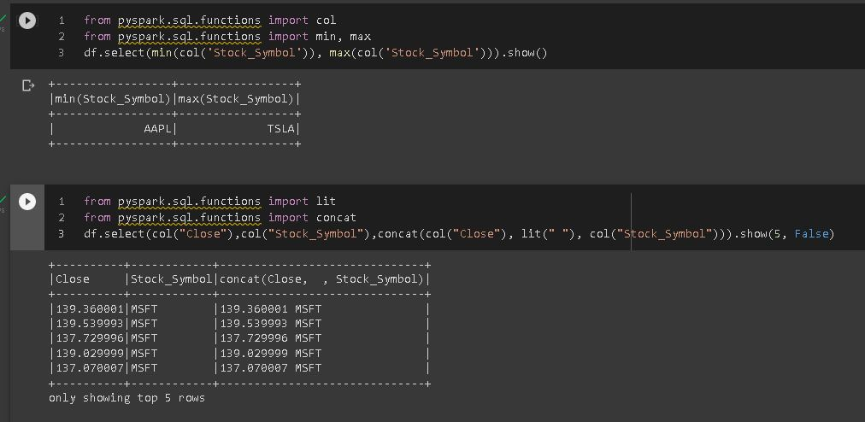
PySpark

Slide 11
Live Project Demonstration

Slide 12
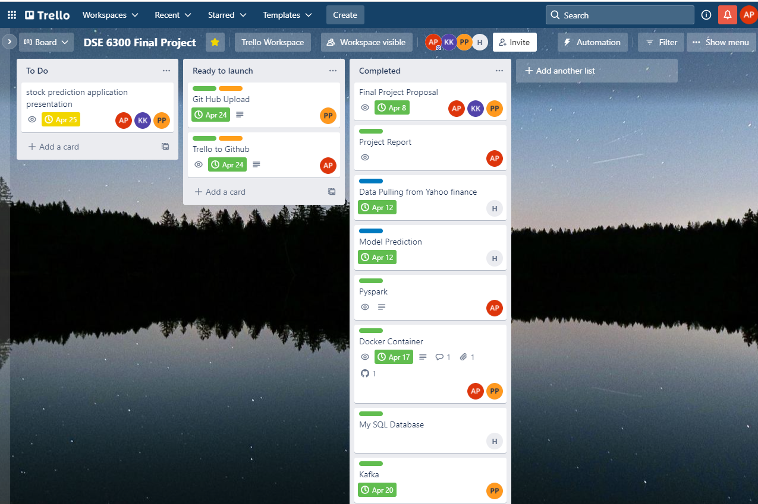
Trello

Slide 13
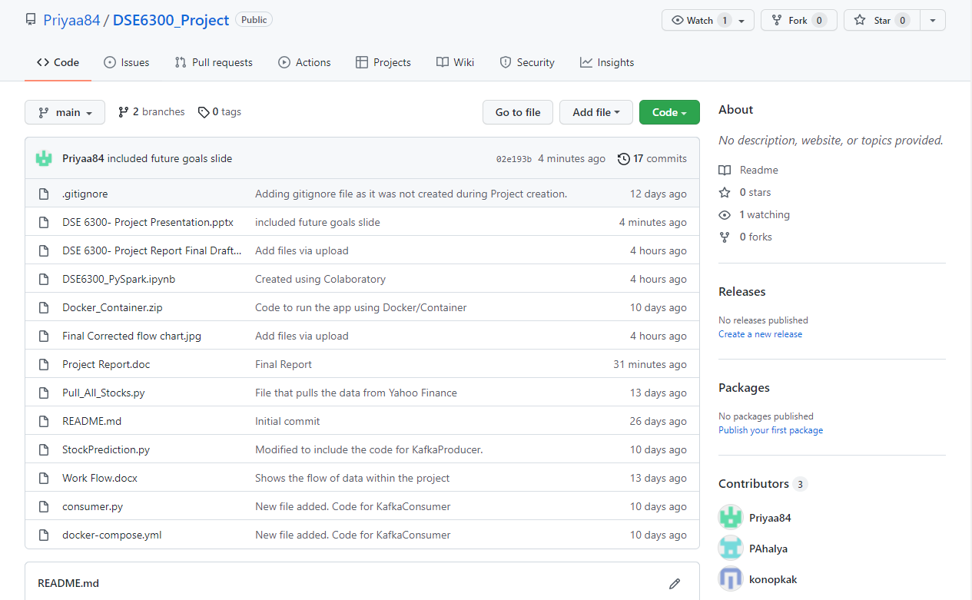
Git Hub
https://github.com/Priyaa84/DSE6300_Project.git

Slide 14
Challenges
Compatibility issues

Slide 15
Future Goals and Improvements
Live Database Use
Optimize model to improve timing
User interactive interface and application

Slide 16


